Slide 1


Chapter 12 Understanding Wireless Networks

Slide 2

Chapter 12 Overview
Exploring basic wireless components
Comparing networking standards and characteristics
Comparing network security methods
Using wireless networks
Understanding point-to-point wireless

Slide 3
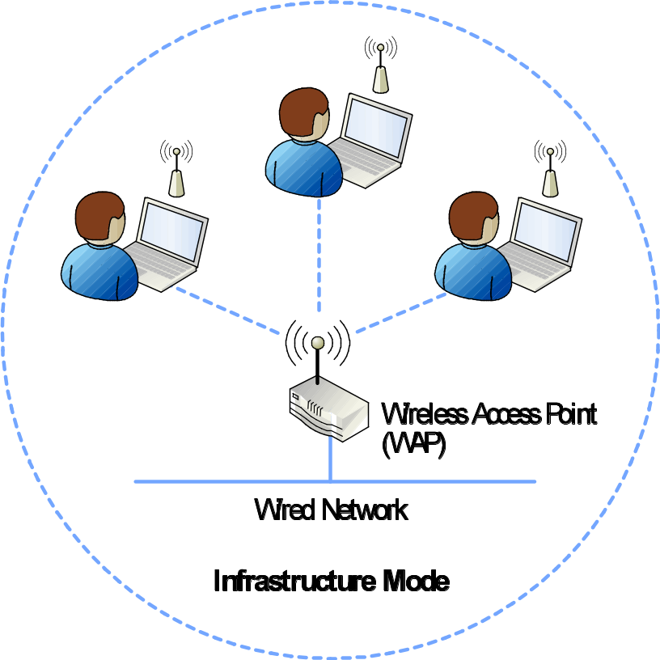
Exploring Basic
Wireless Components
Using wireless access points

Slide 4
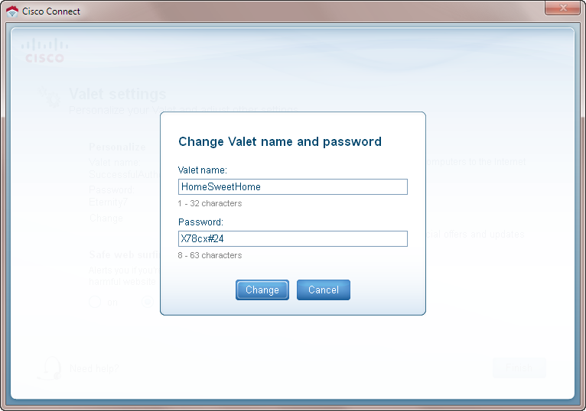
Exploring Basic
Wireless Components
Naming the wireless network
  Service set identifier (SSID)

Slide 5
Exploring Basic
Wireless Components
SSID
  Disabling SID broadcast doesn’t enhance security
  Disabling SSID broadcast does not truly hide the SSID
  Disabling SSID broadcast requires clients to broadcast the SSID

Slide 6
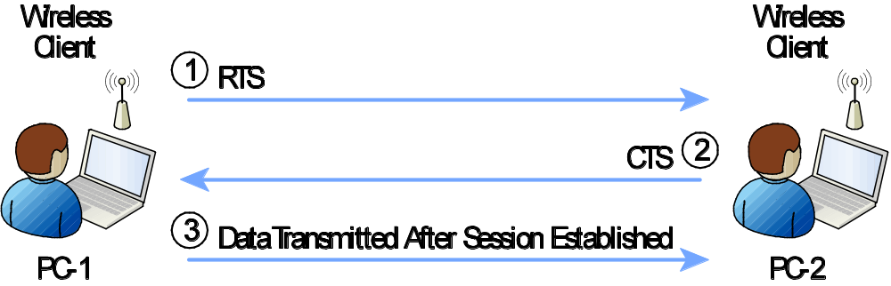
Exploring Basic
Wireless Components
Comparing CSMA and CSMA/CA

Slide 7
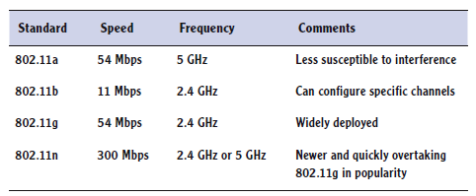
Comparing Networking Standards and Characteristics
Current wireless standards

Slide 8
Comparing Networking Standards and Characteristics
Frequency-hopping spread spectrum (FHSS)
Direct-sequence spread spectrum (DHSS)
Orthogonal frequency division multiplexing (OFDM)

Slide 9
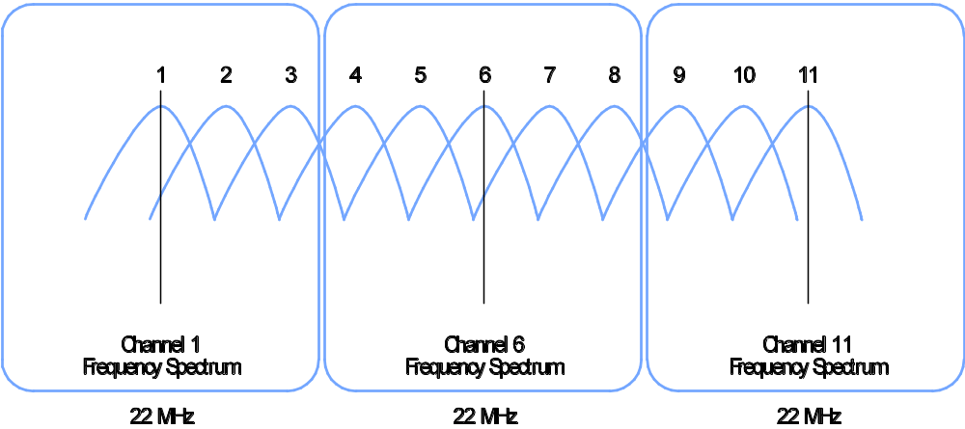
Comparing Networking Standards and Characteristics
FHSS, DHSS, OFDM
  DHSS channels

Slide 10
Comparing Networking Standards and Characteristics
IEEE 802.11
  IEEE 802.11a
  IEEE 802.11b
  IEEE 802.11g
  IEEE 802.11n

Slide 11
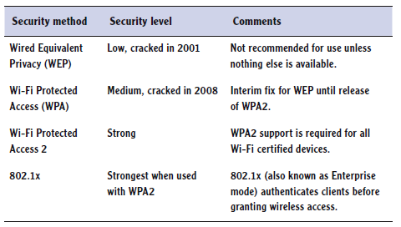
Comparing Network
Security Methods
Wireless security methods

Slide 12
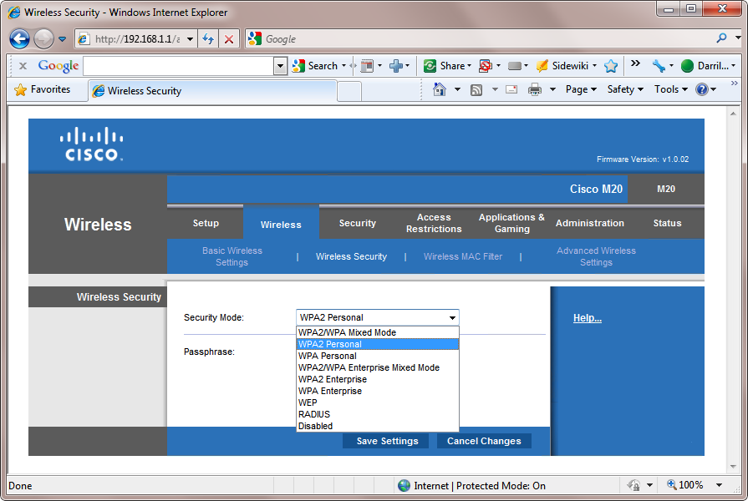
Comparing Network
Security Methods
Wireless security methods

Slide 13
Comparing Network
Security Methods
Wireless Equivalent Privacy (WEP)
  Poor security
  Use was optional
  Weak encryption
  Poor key management
  Cracking software widely available

Slide 14
Comparing Network
Security Methods
Wi-Fi Protected Access (WPA)
  Improved WEP
Wi-Fi Protected Access 2 (WPA2)
  Improved WPA

Slide 15
Comparing Network
Security Methods
WPA and WPA2 both support
  Personal mode
    Uses preshared key
  Enterprise mode
    Uses 802.1x server for authentication

Slide 16
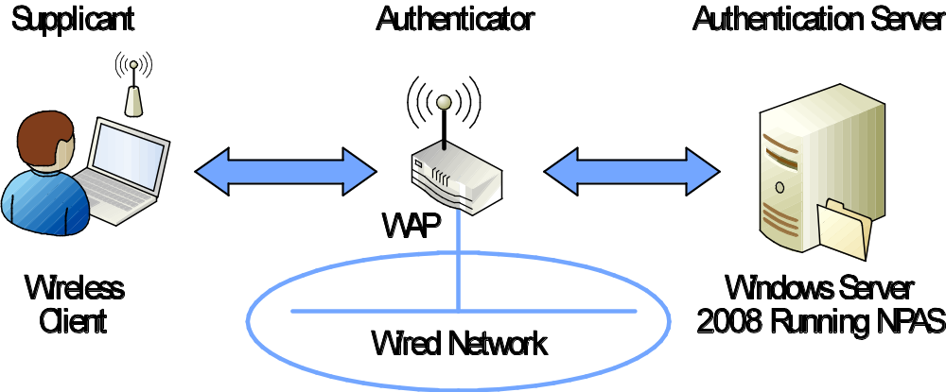
Comparing Network
Security Methods
IEEE 802.1x authentication server

Slide 17
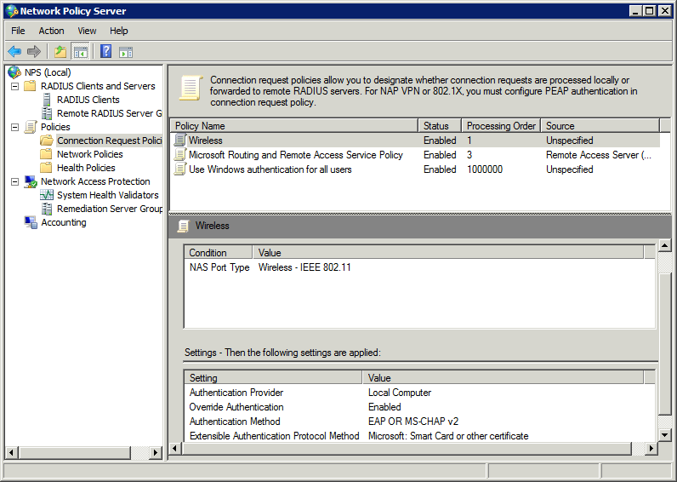
Comparing Network
Security Methods
NPAS role used for 802.1x

Slide 18
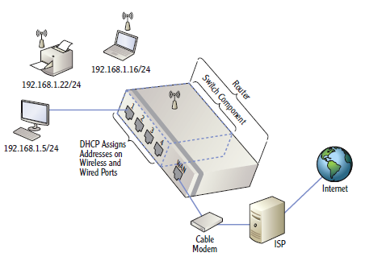
Using Wireless Networks
Wireless router components
  WAP
  Switch
  Router
  DHCP

Slide 19
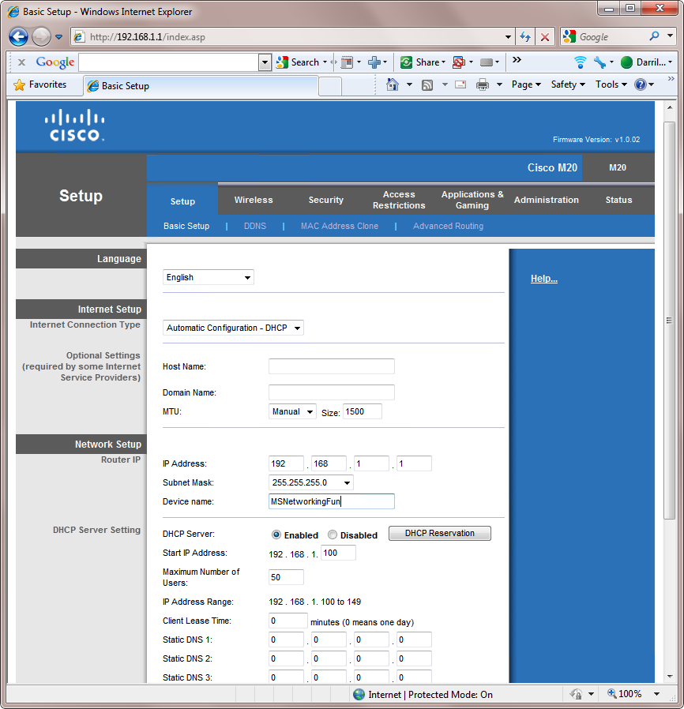
Using Wireless Networks
Wireless web interface

Slide 20
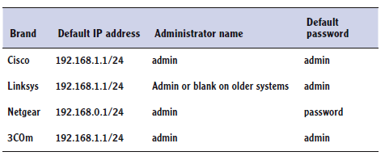
Using Wireless Networks
Common wireless router defaults

Slide 21
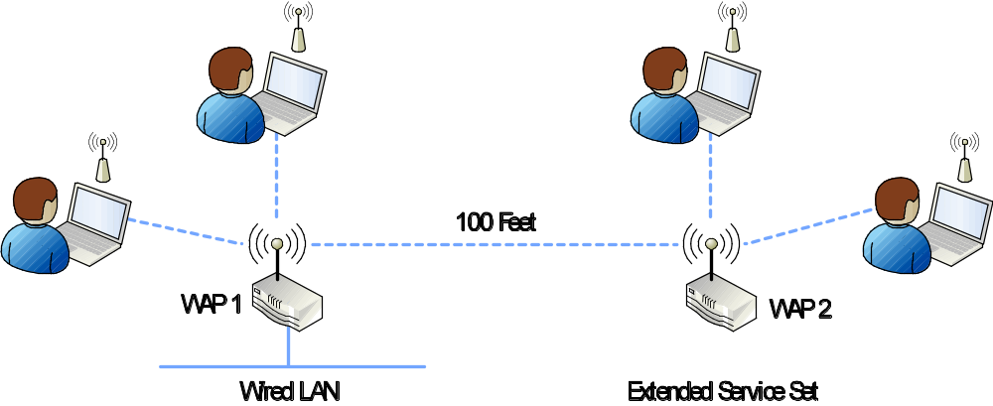
Using Wireless Networks
Wireless networks in a business
  Basic service set
  Extended service set

Slide 22
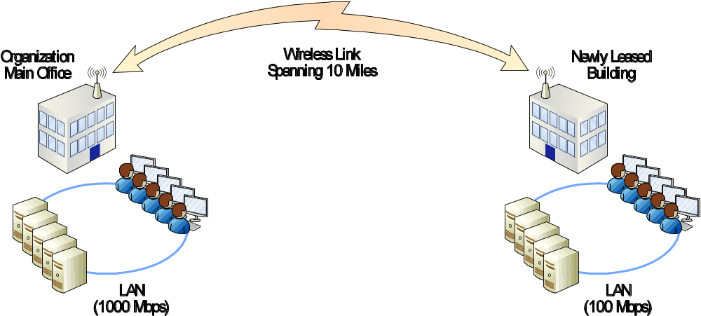
Understanding
Point-to-point Wireless
Connect two networks together with wireless technologies
  P2P wreless bridge

Slide 23
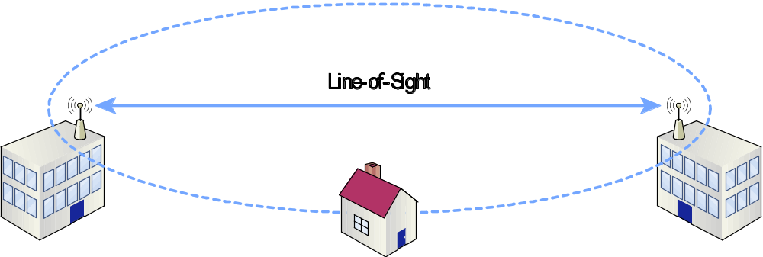
Understanding
Point-to-point Wireless
Evaluating the Fresnel zone
  Identifies interference

Slide 24
Chapter 12 Summary
Exploring basic wireless components
Comparing networking standards and characteristics
Comparing network security methods
Using wireless networks
Understanding point-to-point wireless

